Slide 1
Google Cloud Study Jams EDU Community Organizer Guide 2019

Slide 2
What is a Study Jam?
A Community Training Experience
Study Jams are community-run study groups for developers. This is a great opportunity to bring members of your community together to learn something in person.
These trainings will give your community members a specific skill they can use for personal development or career advancement.
.
Types of Study Jams
Google Cloud
Mobile Site Certification
Machine Learning

Slide 3



Why run a Google Cloud Study Jam?
With a Cloud Study Jam, your community members and you will learn the fundamental tools and capabilities of Google Cloud.
Attendees will receive free access to our online labs. You can choose any of our recommended tracks to run with your community: Machine Learning, Kubernetes, Certification, IoT, and Security.
After the session, attendees can continue taking labs to earn Google Cloud badges. Encourage your community to continue learning by holding another session and staying in touch online!
Free access to Qwiklabs hands-on labs, a $55+ value
Earn Google Cloud badges to show your skills and expertise
No need to register with a credit card
Need assistance? Email support@qwiklabs.com anytime.
Free access to Qwiklabs hands-on labs, a $70+ value
Earn Google Cloud badges to show your skills and expertise
No need to register with a credit card
Need assistance? Email support@qwiklabs.com anytime.

Slide 4
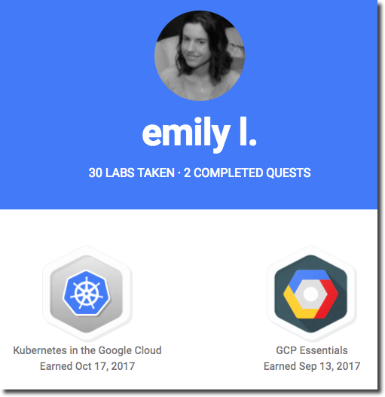
Google Cloud Study Jam
Start with 4 labs to learn basics during the event.
Free access to Qwiklabs hands-on labs, a $55+ value
Earn Google Cloud badges to show your skills and expertise
No need to register with a credit card
Dive deep into a more complex lab: containerizing applications or data engineering.
After the session, attendees can continue taking labs to earn a Google Cloud badge.

Slide 5
Organizing a Cloud Study Jam

Slide 6

Timeline
Find a location and invite your community members
Attendees earn badges
Pre-event
Hold the Cloud Study Jam
Post-event
Organizers completes GCP Essentials courses and take 4 or more hand-on labs to prepare to lead the session
Continue supporting and communicating with your community

Slide 7
Organizer checklist
Pre-Event | Post-Event
⬜ Submit the event registration form | ⬜ Run the in-person event
⬜ Register your event on Meetup.com | ⬜ Share slides with attendees
⬜ Find a Venue | ⬜ Enter attendees on Meetup.com
⬜ Register for the Facilitator mailing list | ⬜ Encourage your attendees online
⬜ Optional: Join Facilitator Hangout | ⬜ Submit post-event survey
⬜ Set up online channel for attendees | ⬜ Celebrate graduation with attendees
⬜ Facilitators complete the labs (4 hours)
⬜ Send pre-event message
Use this checklist to track your readiness for the event and encourage your community to stay involved even after your Cloud Study Jam session!

Slide 8
Attendee Registration
Registration Methods
Registering your attendees early on is essential.
It’s helpful to have an idea of how many people are attending and their interests, so you can prepare the best agenda, swag, food, etc.
Information to Gather
The information you collect is up to you, but here are a few suggestions:
Name and email address (basic contact info)
What GCP products they are interested in
Experience level as a developer
Dietary restrictions (if you plan on providing food)

Slide 9
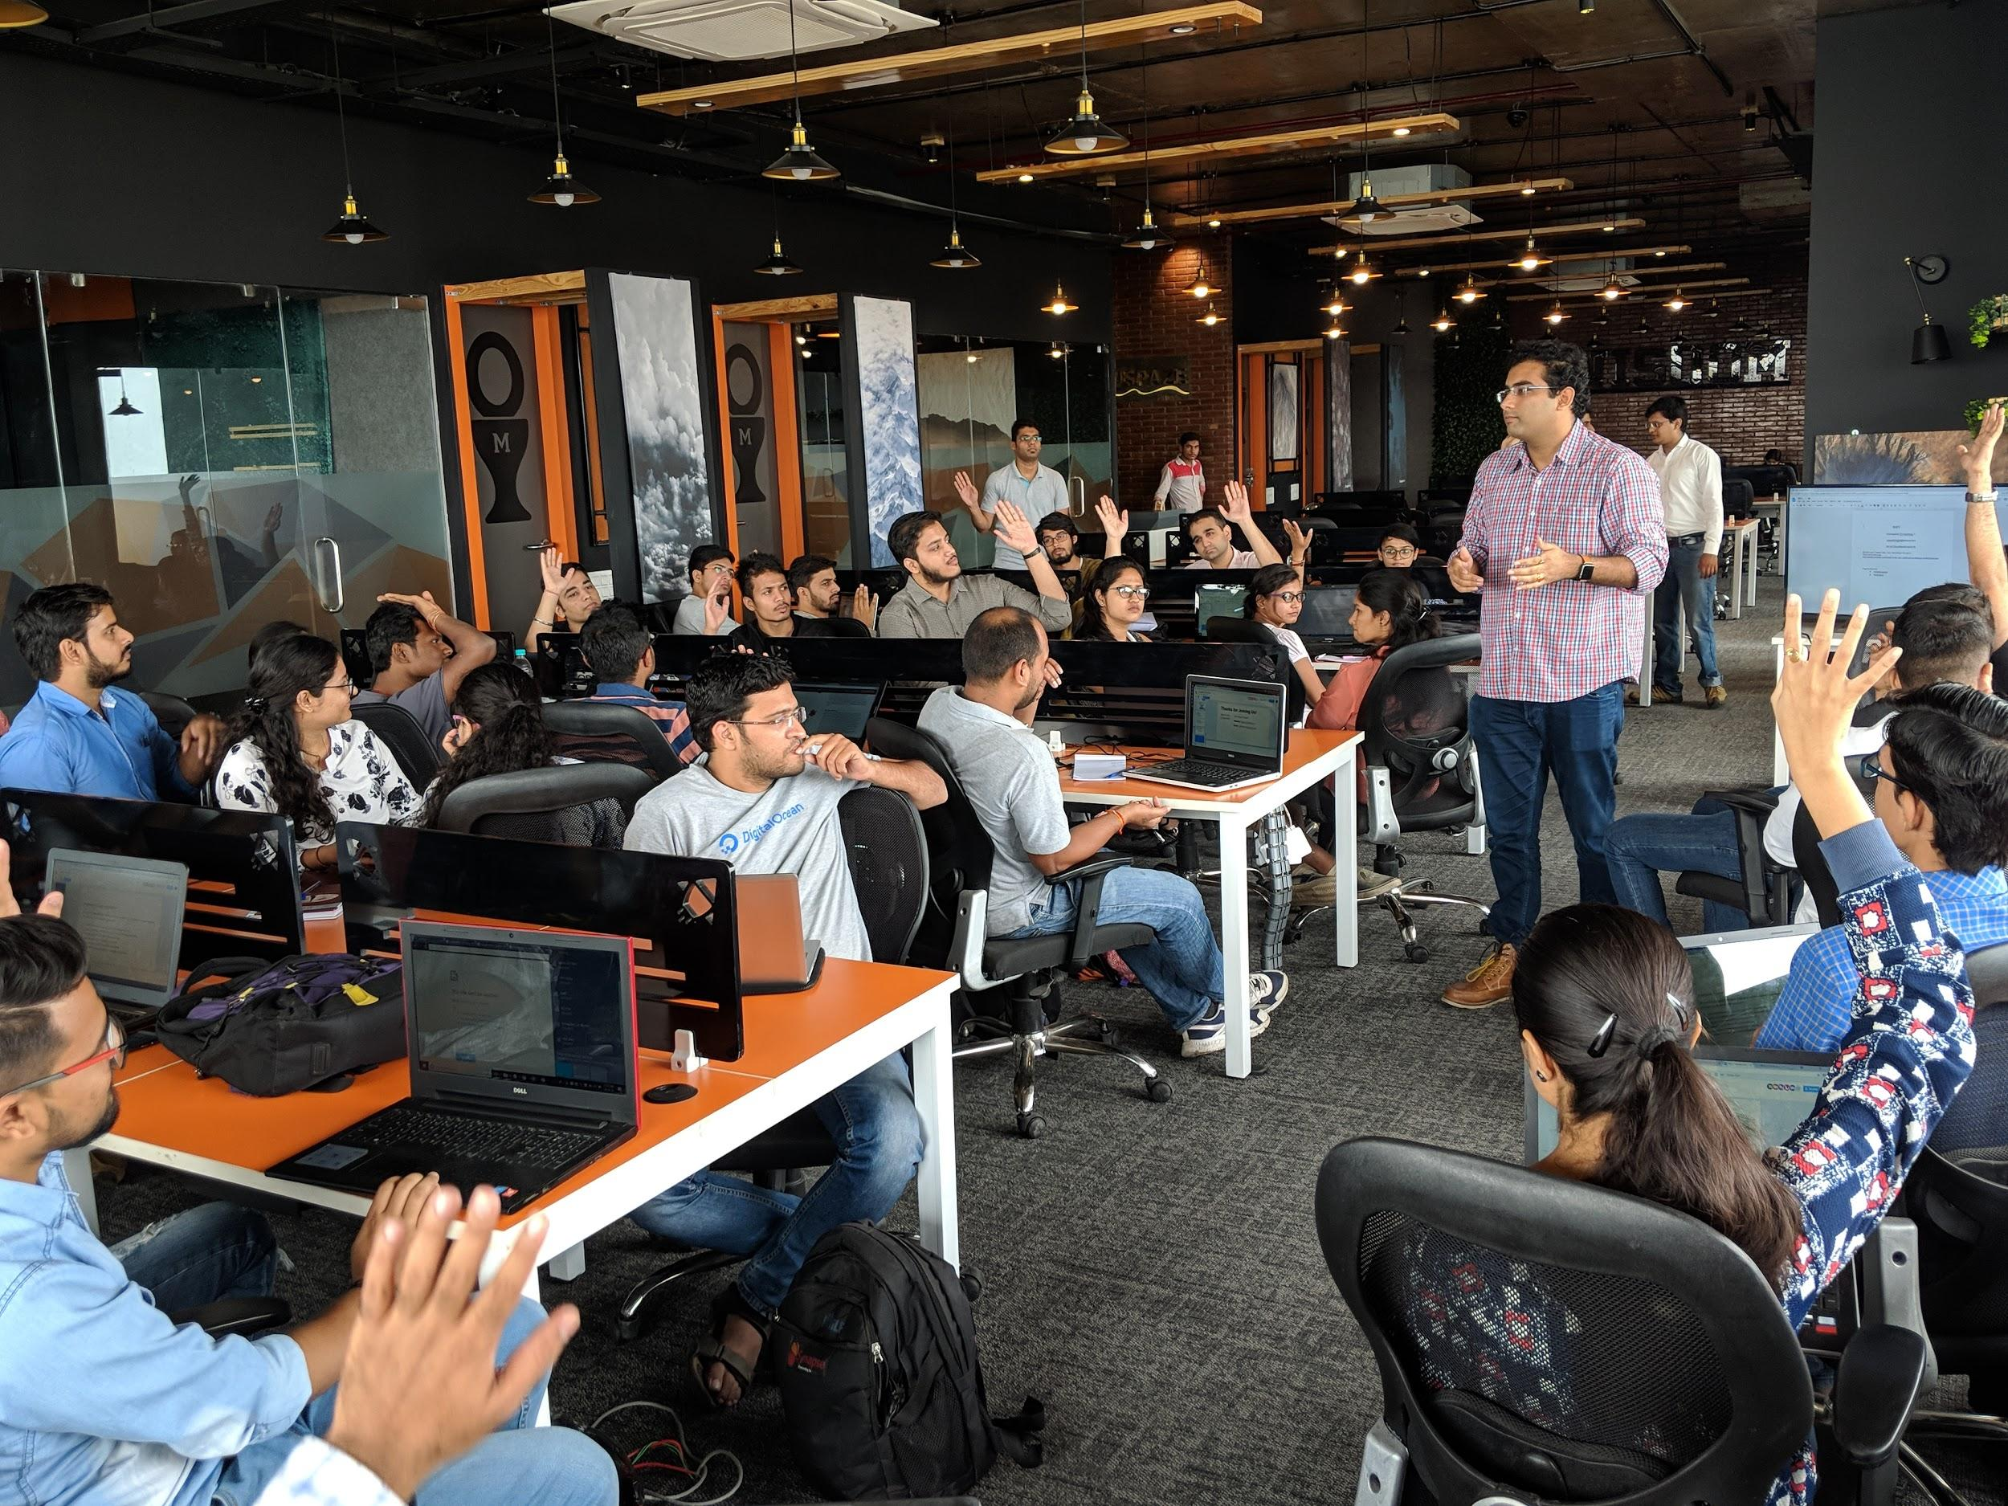
Find a venue
Find a venue which has:
Internet connection, wifi or ethernet. The labs require a connection to run.
Chairs and tables. Attendees will be using their laptops.
Power outlets. The event will run for about three hours.
Optional: A projector that the Facilitator can use to share their screen with attendees.
GDG New Brunswick, 2018

Slide 10
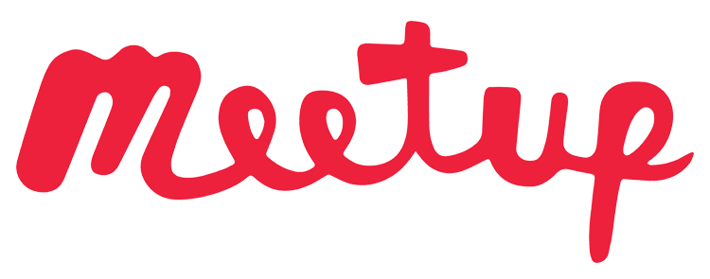
Register your Cloud Study Jam on Meetup.com*, Dicoding or other event site
*This step is NOT relevant for Developer Student Clubs.
When entering your event details...
The event title must contain the words “Cloud Study Jam”.
Make the event four hours long.
Feel free to write your own event description or copy parts or all of the sample description on the next page.
This step is optional for Developer Student Clubs. If you have other channels that you use to communicate with your community, you can continue to do so.
*This step is mandatory for GDGs and Google Cloud Developer Communities

Slide 11
Example Cloud Study Jam Description*
Want to get started on the Google Cloud, but don't know where to begin? Join us for our Cloud Study Jam!
Get official Google training, a $55+ value, free of charge. Together we'll work through 4 Google Cloud labs. You will get hands-on experience with the cloud console, Kubernetes and Machine Learning.
Then after the meetup, you will have free access to 3 more labs you can finish at home. Complete all 7 labs and earn a Google-hosted badge for your online profile.
Bring a laptop (PC, Mac or Chromebook)! The labs will run on all of the latest versions of the popular browsers. For the best experience, make sure your laptop has Firefox or Chrome installed.
Agenda:
9:00am: 4 Google Cloud Platform Essentials labs
11:00am: Break
11:40am: Intro to Docker or Scientific Data Processing lab (Demo)
1:00pm: Event ends
* This is a sample description. Feel free to personalize to your community.

Slide 12
Example: Google Cloud Study Jam agenda
Agenda
9:00 | Welcome!
9:05 | Get free access to Qwiklabs
9:15 | Overview of GCP Essentials
9:30 - 11:40 | Lab 1: Creating a Virtual Machine Lab 2: Getting started with Cloud Shell and gcloud Lab 3: Provision Services with Cloud Launcher Break Lab 4: Creating a Persistent Disk
11:40 | Demo of either Intro to Docker or Scientific Data Processing (facilitator’s choice)
12:40 13:00 | Discussion: How to apply Google Cloud in your mobile projects Event ends - THANK YOU!
2h | Introduction to GCP, Complete three GCP Essentials labs together.
15min | Break.
1h 45 mins | Complete fourth lab together, Demo of lab 1 of another quest , Group Discussion Share your photos online with the hashtag #CloudStudyJam!
At home | Complete the remaining three GCP Essentials labs to earn a badge and an additional month of free Qwiklabs access!
At home | Use your free access to learn and earn badges in Kubernetes, Scientific Data Processing, Deployment Manager, Cloud Architecture, Developing Applications, Data Engineering, or Windows on GCP. You choose!
At home | Share your progress with fellow attendees online. (Facilitator to share online channel for your group).

Slide 13

Together, as a team
Set up online channel for attendees. Pick one that works in your community. Use this channel to share the slides and encourage your attendees to complete the labs at home.
Make sure you invite your attendees to join the conversation! Some possibilities:
Comments field on Meetup.com
Facebook group
Mailing list
Slack channel
Google+ community
Remind attendees to post using #CloudStudyJam19

Slide 14
If facilitators haven’t completed the labs or wish to review, complete the labs
When your Qwiklabs credits arrive at the email address(es) you specified in the event form…
Each leader in your group will have the opportunity to complete both labs ahead of the event by completing the following steps:
Complete these four labs:
Creating a Virtual Machine
Getting started with Cloud Shell and gcloud
Provision Services with Cloud Launcher
Creating a Persistent Disk
Then, select one of the following for your jam session:
Introduction to Docker (first lab in the Kubernetes in the Google Cloud Quest)
Rent-a-VM to Process Earthquake Data (first lab in the Scientific Data Processing Quest)
Take five codes each.
Create a Qwiklabs account at google.qwiklabs.com.
Go to the lab catalog.
Click GCP Essentials.
Click Enroll in this quest.
Select the first lab in the quest.
Click the Start Lab button.
Enter the first code in the Lab Access dialog box and take the lab.
Any trouble? Contact Support@Qwiklabs.com

Slide 15

Send pre-event message
A few days before the event, send a message to your attendees. See the next page for a template. Feel free to customize!

Slide 16
Sample Email We are looking forward to seeing you at the Cloud Study Jam event at <TIME> on <DATE>!
At the Cloud Study Jam, we’ll use a tool called “Qwiklabs,” a Google training product. If you have used Qwiklabs before, great! Make sure you know your password. If you have never used Qwiklabs before, save time by creating an account for yourself prior to the class at: https://google.qwiklabs.com/users/sign_up (creating an account is free). At the Cloud Study Jam, we will give you a link for free Qwiklabs access. Make sure you check the opt-in box for promos! That makes you eligible for additional free access after you complete the first series of labs.
What to bring to the Cloud Study Jam:
Laptop -- Mac, PC, Chromebook, Linux, everyone’s welcome.
Laptop charger.
The labs will run on all of the latest versions of the popular browsers. For the best experience, use Firefox or Chrome.
Looking forward to seeing you at the event!

Slide 17
How to use the Cloud Study Jam attendee slides?
Event organizer, during the event:
Use these slides to drive the agenda during your Cloud Study Jam in-person event.
If you have a projector, pull up the slides on your computer and show them to the audience. Start with the next slide.
If you don’t have a projector, ask your attendees to go to these slides at bit.ly/EDU_CloudStudyJam2019 and follow along.
Attendee, after the event: Use these slides as reminder of what you have done and direction for what you’ll be doing next.

Slide 18


Run the in-person Cloud Study Jam
1. Slides
Use the slides at bit.ly/EDU_CloudStudyJam2019
Project if possible, or share the link and ask attendees to follow along.
2. Share the Qwiklabs code
When you display the Let’s Get Started slide, share the special Qwiklabs link you received from Google.
3. Join the conversation!
Share photos and your attendees’ accomplishments using #CloudStudyJam19.
4. Wrap up
Show the final slide of the mountaineer and encourage attendees to finish their quests at home to earn Google Cloud badges.
5. Continue the journey
What’s next? All attendees who complete the quest will become eligible for the Google Cloud career readiness program and earn additional access to labs to continue the journey to cloud mastery!

Slide 19
Need assistance? Email support@qwiklabs.com anytime.
24/7/365
The Qwiklabs team is available to help.

Slide 20


Send post-event message
Share the links with your attendees in the online channel bit.ly/EDU_CloudStudyJam2019
bit.ly/CareerReadinessOverview
Remind attendees online to:
Finish the GCP Essentials labs to earn the GCP Essentials quest badge, plus get another month of free access to earn additional badges..
Opt-in to emails from Qwiklabs to get additional access to Qwiklabs. Confirm your settings at: qwiklabs.com/my_account/profile.
Apply for the Google Cloud career readiness program at g.co/edu/cloudready.

Slide 21

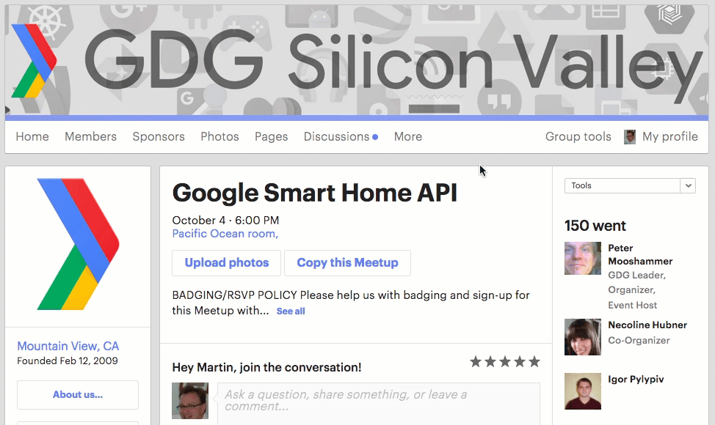
Enter attendee count on Meetup.com*
After your in-person event, enter the actual number of attendees on Meetup.com.
Select your event.
Click Tools.
Click Edit attendance.
Click Checked in
Enter attendee count in the Total text box.
Click the Update button.
* This step is mandatory for GDGs and optional for other groups

Slide 22
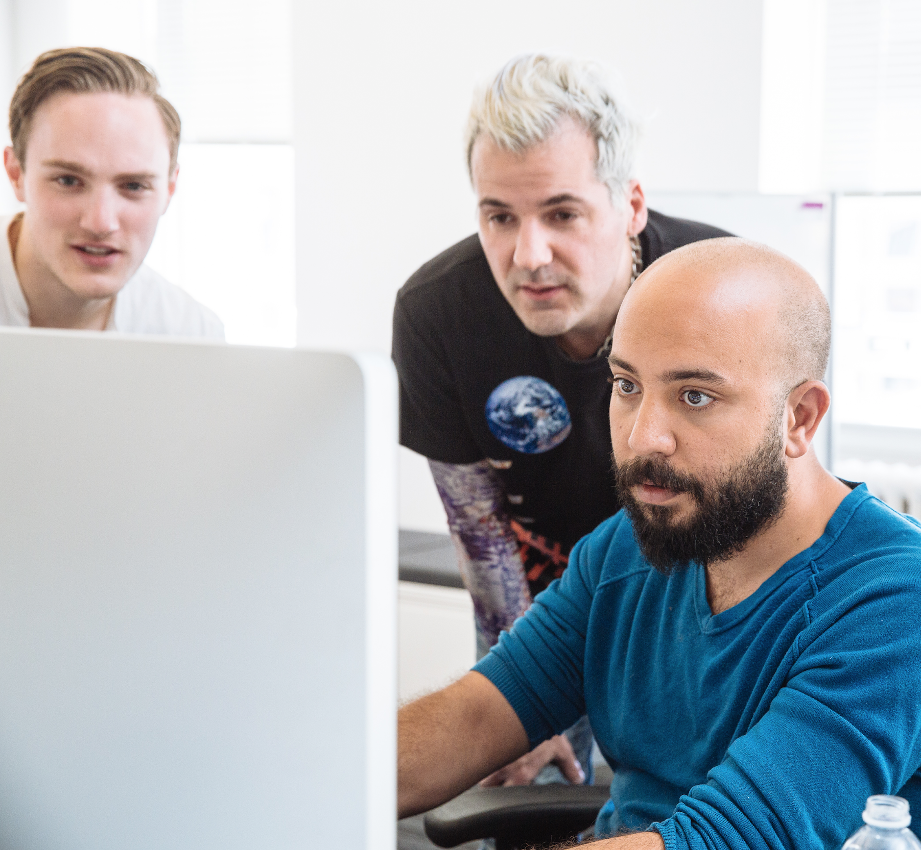
Encourage your attendees online
Encourage attendees to post in your online channel when they earn each badge and praise them when they do! Also tell them that they can post their questions there.
You can collect the questions and ask Google in the Cloud Study Jam mailing list. If attendees have problems with Qwiklabs access or credit, refer them to support@qwiklabs.com and the team will be happy to help.
Reach out to attendees you haven’t heard from and ask how they are doing.

Slide 23
Celebrate graduation!
The next time your group has an in-person meeting, review the Cloud Study Jam that you completed together.
You might ask anyone in the audience who earned at least one badge to come up and then give everyone a round of applause.
Your attendees have worked hard and learned a lot. They deserve to be celebrated, and so do you!

Slide 24
FAQ
Q: Will Google sponsor my Cloud Study Jam? A: There is no central budget allocated for this Study Jam. As it’s only a single in-person event, we hope it will be easy for you to run. Your local Google contact may have additional region-specific info.
Q: Can I create swag for my attendees? A: Yes! Please access this Swag Designs page.
Q: Do I have to follow the event format in this guide? Can I run more events? A: Feel free to tweak the format, as long as you run at least one in-person event and you share the campaign link that was emailed to you. Your attendees will then have one month’s free access to Qwiklabs. You can run multiple events where you complete additional labs together if you wish. This would be a good way to build up your local community.
Q: Can I share the Qwiklabs link with people not attending in person? A: Only share this link with people attending your event in person. The link will only work during your event.
Q: My question wasn’t answered here! A: Question about the labs? Support@Qwiklabs.com can help. Otherwise, post your question to the Facilitator mailing list.

Slide 25
That’s a wrap.

Slide 26
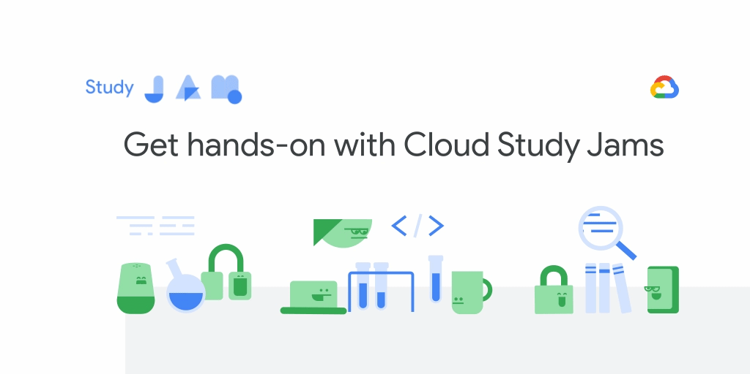
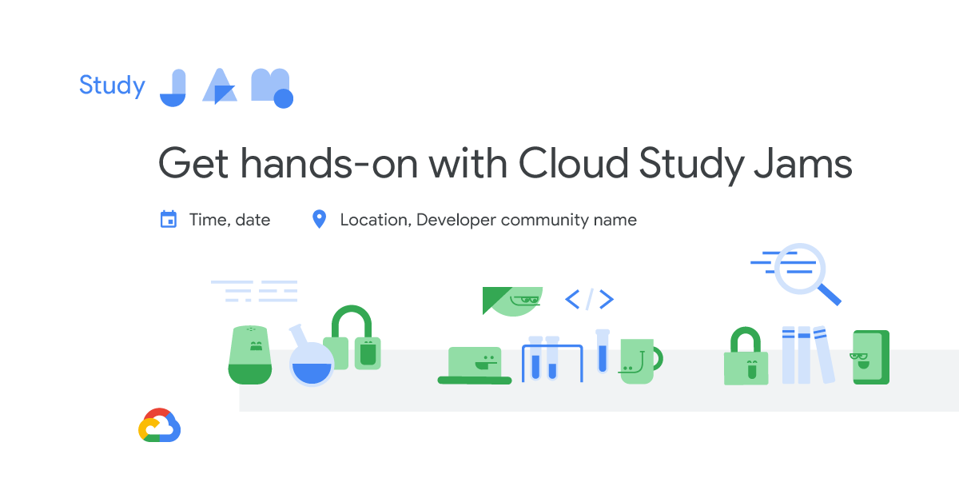
Digital Assets
GIF Banners
Event Banner Templates
Free access to Qwiklabs hands-on labs, a $70+ value
Earn Google Cloud badges to show your skills and expertise
No need to register with a credit card
Need assistance? Email support@qwiklabs.com anytime.

Slide 27
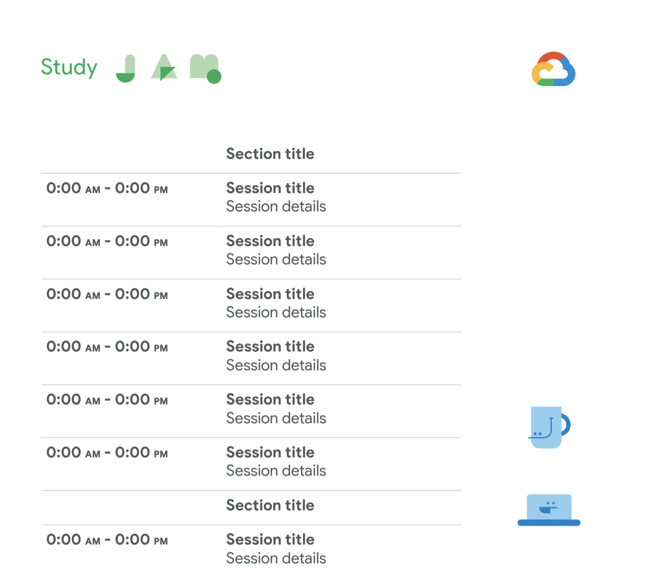
Digital Assets
Agenda
Free access to Qwiklabs hands-on labs, a $70+ value
Earn Google Cloud badges to show your skills and expertise
No need to register with a credit card
Need assistance? Email support@qwiklabs.com anytime.

Slide 28
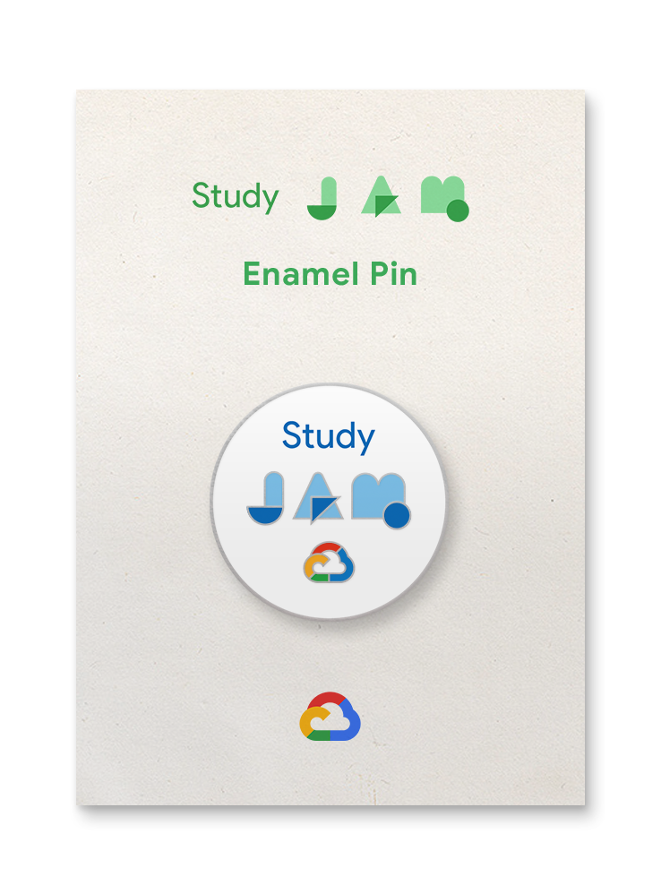
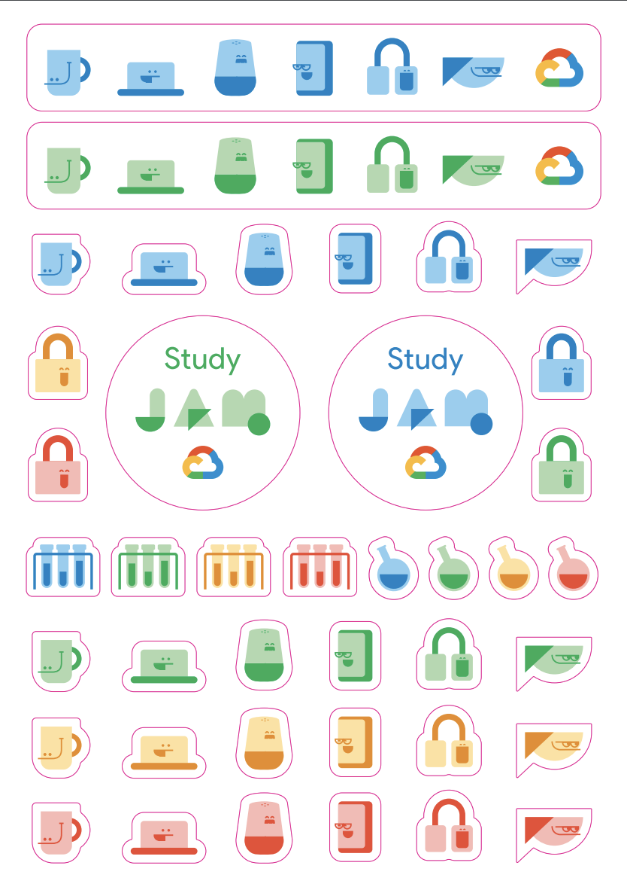
Swag Designs
Enamel Pins
Sticker Sheet
Free access to Qwiklabs hands-on labs, a $70+ value
Earn Google Cloud badges to show your skills and expertise
No need to register with a credit card
Need assistance? Email support@qwiklabs.com anytime.

Slide 29
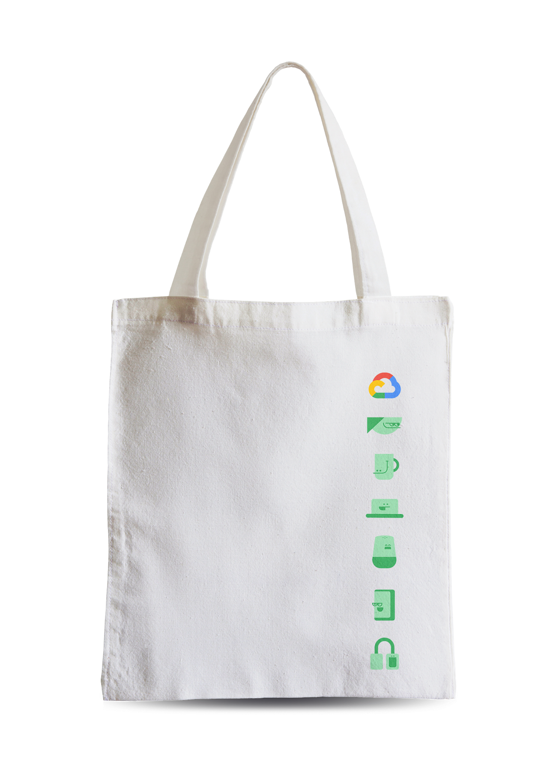
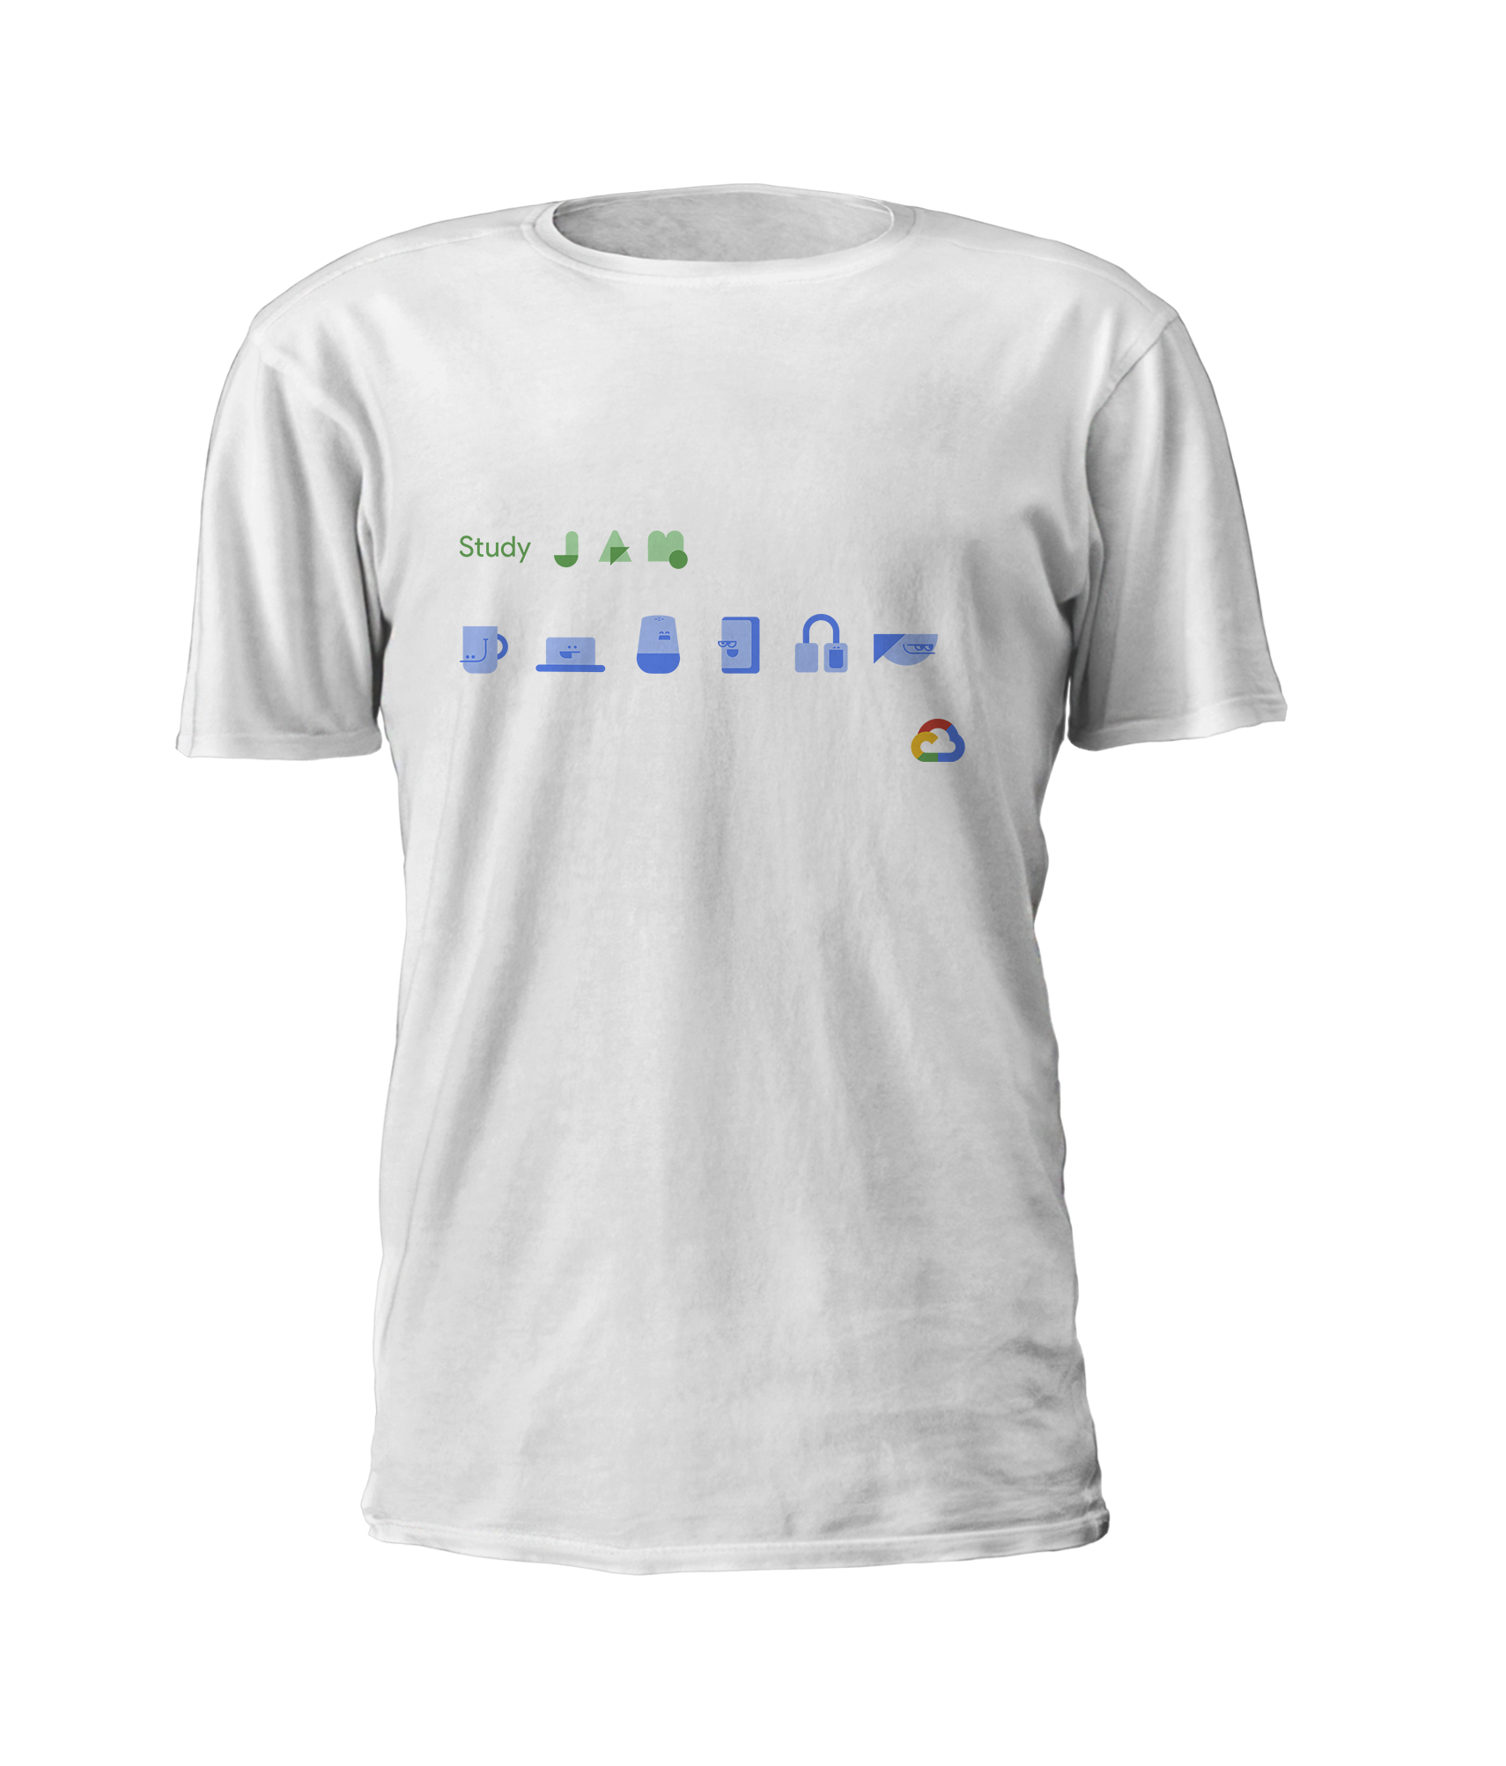
Swag Designs
Tote
T-Shirt Designs
Free access to Qwiklabs hands-on labs, a $70+ value
Earn Google Cloud badges to show your skills and expertise
No need to register with a credit card
Need assistance? Email support@qwiklabs.com anytime.

